Slide 1
Python programming for Spark
Distributed Computing

Slide 2
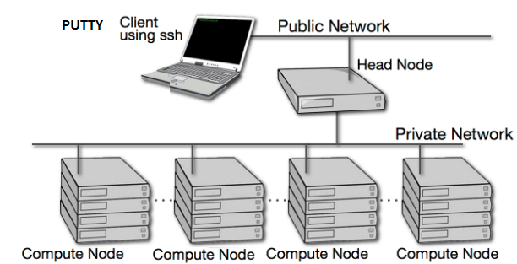
Computing Cluster - Access through PUTTY
us0789lnxp.america.apci.com
901
902
903
904

Slide 3
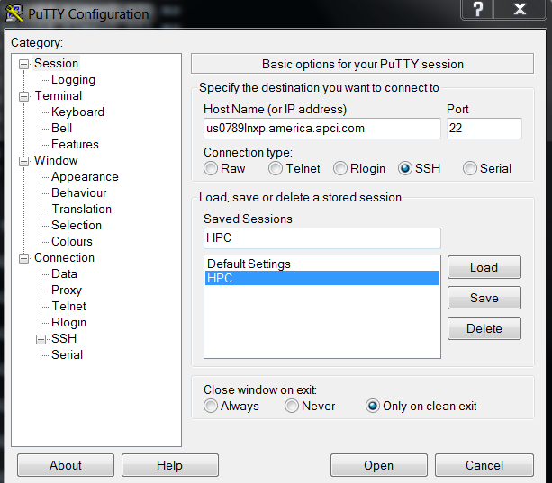
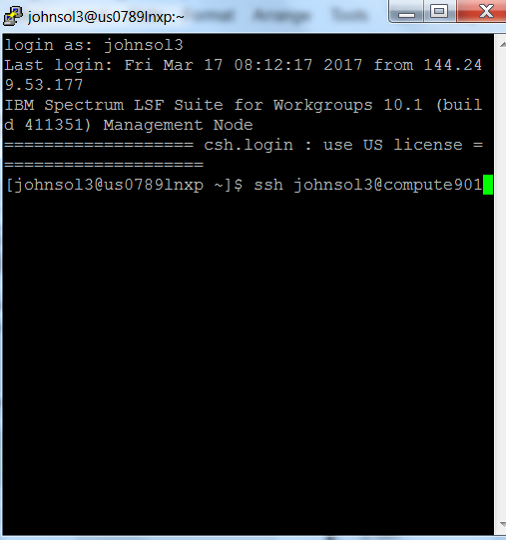
SSH - Bash Shell (cmd line)

Slide 4
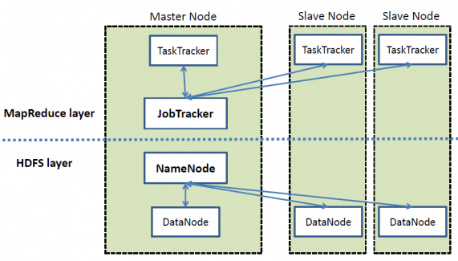
Hadoop - A small Hadoop cluster includes a single master and multiple worker nodes.
The master node consists of a Job Tracker, Task Tracker, NameNode, and DataNode. A slave or worker node acts as both a DataNode and TaskTracker, though it is possible to have data-only worker nodes and compute-only worker nodes. These are normally used only in nonstandard applications.

Slide 5
Network Latency and Replication
High latency among clusters can cause replication jobs to run more slowly, but does not cause them to fail.
For best performance, latency between the source cluster NameNode and the destination cluster NameNode should be less than 80 milliseconds. (You can test latency using the Linux ping command.) As latency increases, replication performance degrades.
[johnsol3@compute901 ~]$ ping compute902
PING compute902 (192.168.8.252) 56(84) bytes of data.
64 bytes from compute902 (192.168.8.252): icmp_seq=1 ttl=64 time=0.089 ms
64 bytes from compute902 (192.168.8.252): icmp_seq=2 ttl=64 time=0.087 ms
64 bytes from compute902 (192.168.8.252): icmp_seq=3 ttl=64 time=0.088 ms
64 bytes from compute902 (192.168.8.252): icmp_seq=4 ttl=64 time=0.079 ms
64 bytes from compute902 (192.168.8.252): icmp_seq=5 ttl=64 time=0.079 ms
64 bytes from compute902 (192.168.8.252): icmp_seq=6 ttl=64 time=0.084 ms
64 bytes from compute902 (192.168.8.252): icmp_seq=7 ttl=64 time=0.078 ms
64 bytes from compute902 (192.168.8.252): icmp_seq=8 ttl=64 time=0.075 ms
64 bytes from compute902 (192.168.8.252): icmp_seq=9 ttl=64 time=0.051 ms
64 bytes from compute902 (192.168.8.252): icmp_seq=10 ttl=64 time=0.078 ms

Slide 6
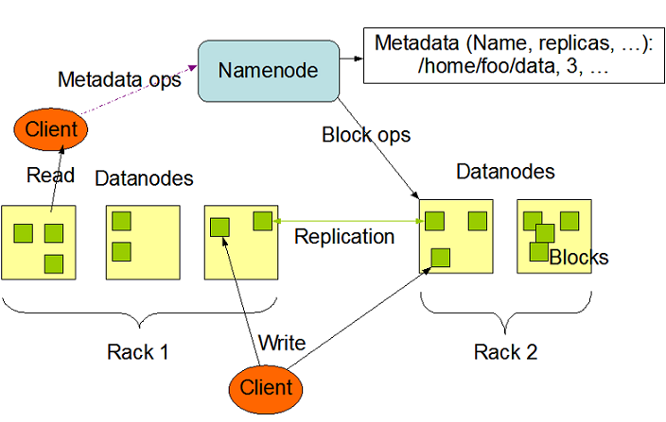
Hadoop - HDFS

Slide 7
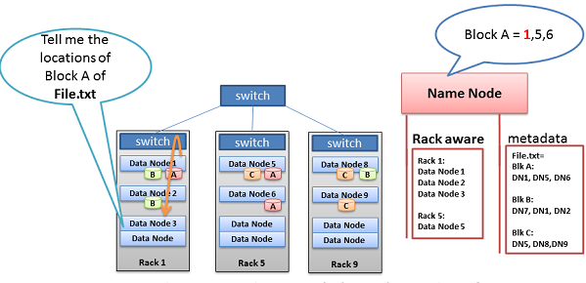
Hadoop - Rack Awareness (beware of shuffling)
This is another key example of the Name Node’s Rack Awareness knowledge providing optimal network behavior. When the Data Node asks the Name Node for location of block data, the Name Node will check if another Data Node in the same rack has the data. If so, the Name Node provides the in-rack location from which to retrieve the data. The flow does not need to traverse two more switches and congested links find the data in another rack. With the data retrieved quicker in-rack, the data processing can begin sooner, and the job completes that much faster.

Slide 8
Local vs Hadoop File Systems
#Spark setup
from pyspark import SparkContext
if __name__ == "__main__":
sc = SparkContext(appName="Pattern Recognition v1",pyFiles=['pdm.py'])
#now have a spark context sc
#read files into spark rdd
lines = sc.textFile("/user/johnsol3/Historical.csv")
hparts = lines.map(lambda l: l.split(","))
lines = sc.textFile("/user/johnsol3/Template.csv")
tparts = lines.map(lambda l: l.split(","))
#read file into numpy array
H_raw = np.genfromtxt('Historical.csv', delimiter=',')
T_raw = np.genfromtxt('Template.csv', delimiter=',')
# Removing timestamp
H = H_raw[:,1:]
T = T_raw[:,1:]

Slide 9
Spark RDD
Resilient Distributed Datasets (RDDs)
- collection of elements that can be operated on in parallel
There are two ways to create RDDs:
- parallelizing an existing collection in your driver program
- referencing a dataset in an external storage system, such as a shared filesystem, HDFS, HBase, or any data source offering a Hadoop InputFormat

Slide 10
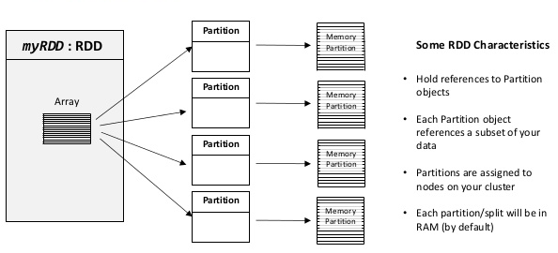
RDD Characteristics

Slide 11
Creating RDD distribute jobs (auto parallelization)
import numpy as np
import sys
from pyspark import SparkContext
if __name__ == "__main__":
sc = SparkContext(appName="RDD with auto parallelization")
# create array
index = np.arange(100)
p_index = sc.parallelize(index)
p_index_size = p_index.count()
print(p_index.getNumPartitions())
print(p_index_size)
res = p_index.map(lambda a: a*5).()
print(res)
print("Finished***********")
sc.stop();

Slide 12
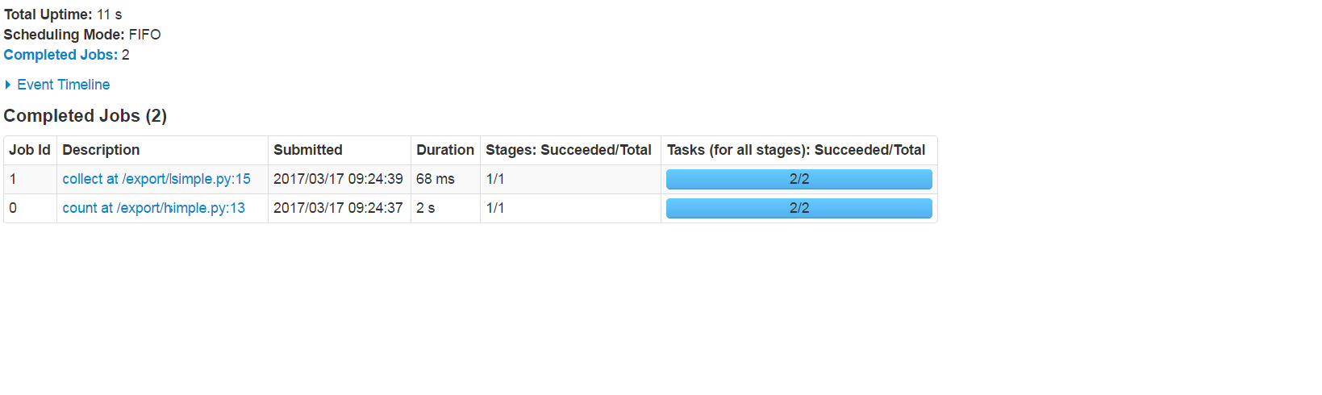
Partitions - lowest level for task distribution

Slide 13
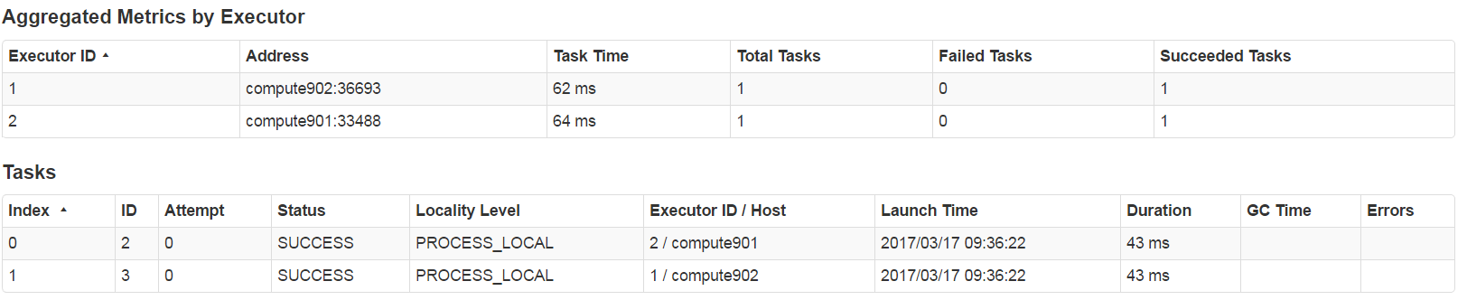
One Task per partition

Slide 14
Creating RDD distribute jobs (manual parallelization)
import numpy as np
import sys
from pyspark import SparkContext
if __name__ == "__main__":
sc = SparkContext(appName="Setting Partition manually")
# create tuples
index = np.arange(100)
pp_index = sc.parallelize(index,10)
print(pp_index.getNumPartitions())
pp_index_size = pp_index.count()
print(pp_index_size)
res = pp_index.map(lambda a: a*5).collect()
print(res)
print("Finished************************************************************************************")
sc.stop();

Slide 15
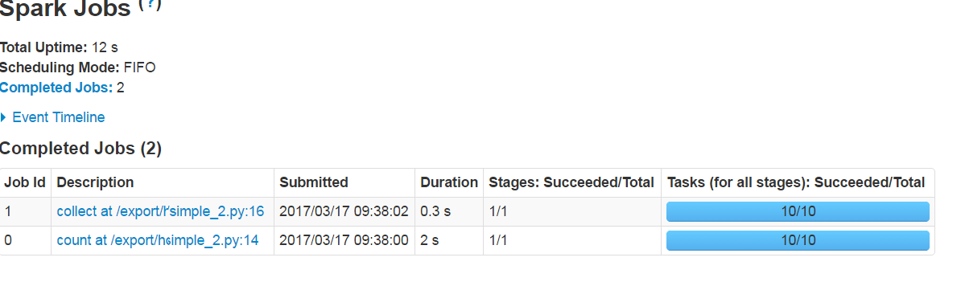
Partitions - lowest level for task distribution

Slide 16
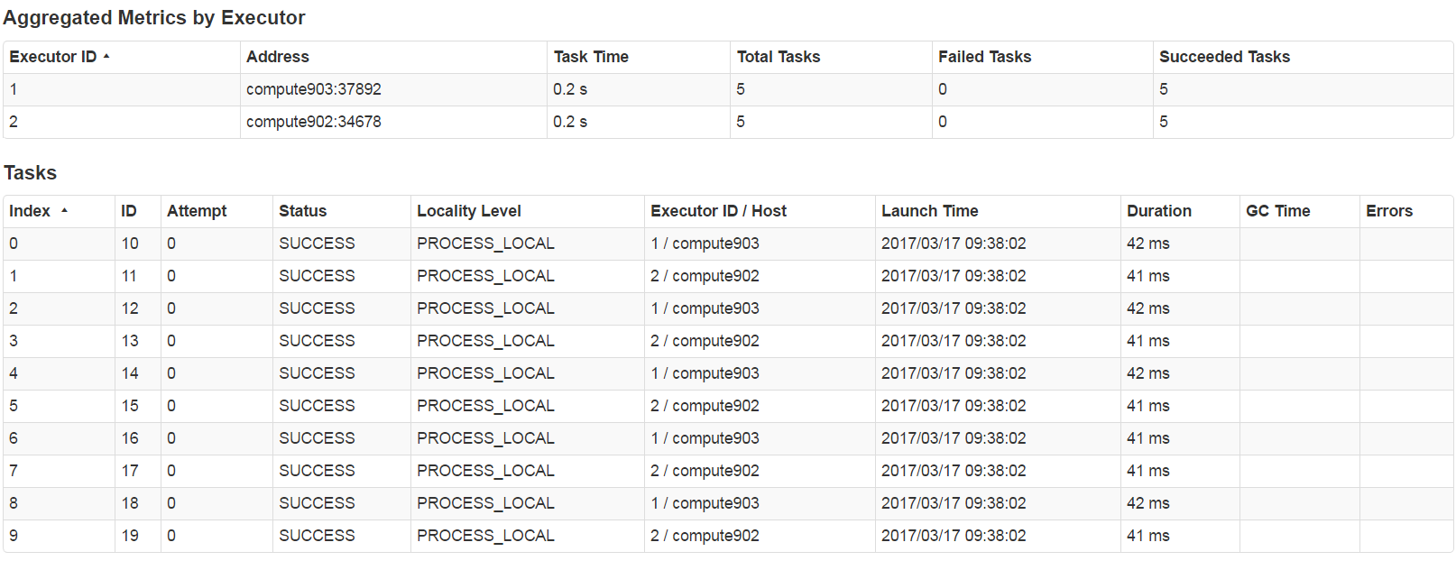
One Task Per Partition

Slide 17
Spark Map-Reduce
textFile = sc.textFile("README")
#You could also pass number of partitions here as well.
def max(a, b):
if a > b:
return a
else:
return b
textFile.map(lambda word: (word, 1)).reduceByKey(lambda a, b: a+b)

Slide 18
Spark Distribution and Parallelization
File System - HDFS
RDD - Array of Objects
Parallelize - Key word level
Partition - keyword
Nodes - Cluster Level
Executor - Node level
There are similar levels of controls for memory usage

Slide 19
Defining Spark Distribution
--master
local Run Spark locally with one worker thread (i.e. no parallelism at all).
local[K] Run Spark locally with K worker threads (ideally, set this to the number of cores on your machine).
local[*] Run Spark locally with as many worker threads as logical cores on your machine.
spark://HOST:PORT Connect to the given Spark standalone cluster master. The port must be whichever one your master is configured to use, which is 7077 by default.

Slide 20
Defining Spark Distribution
1 Task x Partition in cluster
- Typically you want 2-4 partitions for each CPU in your cluster.
- 64 x 4 = 256 cores; 4 * 256 = 1024 partitions

Slide 21
Spark Shuffle
Shuffling is a process of redistributing data across partitions (aka repartitioning) that may or may not cause moving data across JVM processes or even over the wire (between executors on separate machines).
Shuffling is the process of data transfer between stages.
Tip
Avoid shuffling at all cost. Think about ways to leverage existing partitions. Leverage partial aggregation to reduce data transfer.

Slide 22
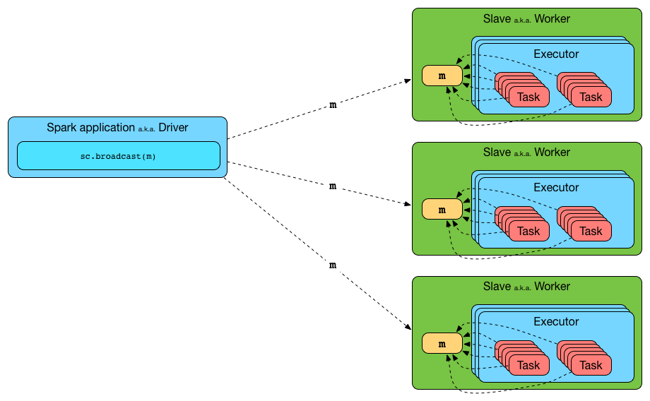
Parallel Computing - Broadcast Variables

Slide 23
Parallel Computing - Broadcast Variables
Broadcast variables allow the programmer to keep a read-only variable cached on each machine rather than shipping a copy of it with tasks. They can be used, for example, to give every node a copy of a large input dataset in an efficient manner. Spark also attempts to distribute broadcast variables using efficient broadcast algorithms to reduce communication cost.
#broadcast historical file to every node
lines = sc.textFile("/user/johnsol3/Historical.csv")
hparts = lines.map(lambda l: l.split(","))
H_broadcast = sc.broadcast(H)
ltw_s = p_tuples.map(lambda window: pdm.ltw_p(index,H_broadcast.value))

Slide 24
Parallel Computing - Partitions
One important parameter for parallel collections is the number of partitions to cut the dataset into.
Spark will run one task for each partition of the cluster. Typically you want 2-4 partitions for each CPU in your cluster.
Normally, Spark tries to set the number of partitions automatically based on your cluster. However, you can also set it manually by passing it as a second parameter to parallelize (e.g. sc.parallelize(data, 10)

Slide 25
Tuning Resource Allocation
To hopefully make all of this a little more concrete, here’s a worked example of configuring a Spark app to use as much of the cluster as possible: Imagine a cluster with six nodes running NodeManagers, each equipped with 16 cores and 64GB of memory. The NodeManager capacities, yarn.nodemanager.resource.memory-mb and yarn.nodemanager.resource.cpu-vcores, should probably be set to 63 * 1024 = 64512 (megabytes) and 15 respectively. We avoid allocating 100% of the resources to YARN containers because the node needs some resources to run the OS and Hadoop daemons. In this case, we leave a gigabyte and a core for these system processes. Cloudera Manager helps by accounting for these and configuring these YARN properties automatically.

Slide 26
Tuning Resource Allocation
The likely first impulse would be to use --num-executors 6 --executor-cores 15 --executor-memory 63G. However, this is the wrong approach because:
63GB + the executor memory overhead won’t fit within the 63GB capacity of the NodeManagers.
The application master will take up a core on one of the nodes, meaning that there won’t be room for a 15-core executor on that node.
15 cores per executor can lead to bad HDFS I/O throughput.
A better option would be to use --num-executors 17 --executor-cores 5 --executor-memory 19G. Why?
This config results in three executors on all nodes except for the one with the AM, which will have two executors.
--executor-memory was derived as (63/3 executors per node) = 21. 21 * 0.07 = 1.47. 21 – 1.47 ~ 19.

